Slide 1
Ace Dr. Cook’s Chem 1421:
Metacognition is the Key!
Saundra Y. McGuire, Ph.D.
Retired Asst Vice Chancellor & Professor of Chemistry
Director Emerita, Center for Academic Success

Slide 2

What’s your career track?
Education
Engineering
Pre-Dent
Pre-Med
5. Pre-Nursing
6. Pre-Pharmacy
7. Pre-Vet
8. Other Pre-Health
9. Other
10
Countdown

Slide 3
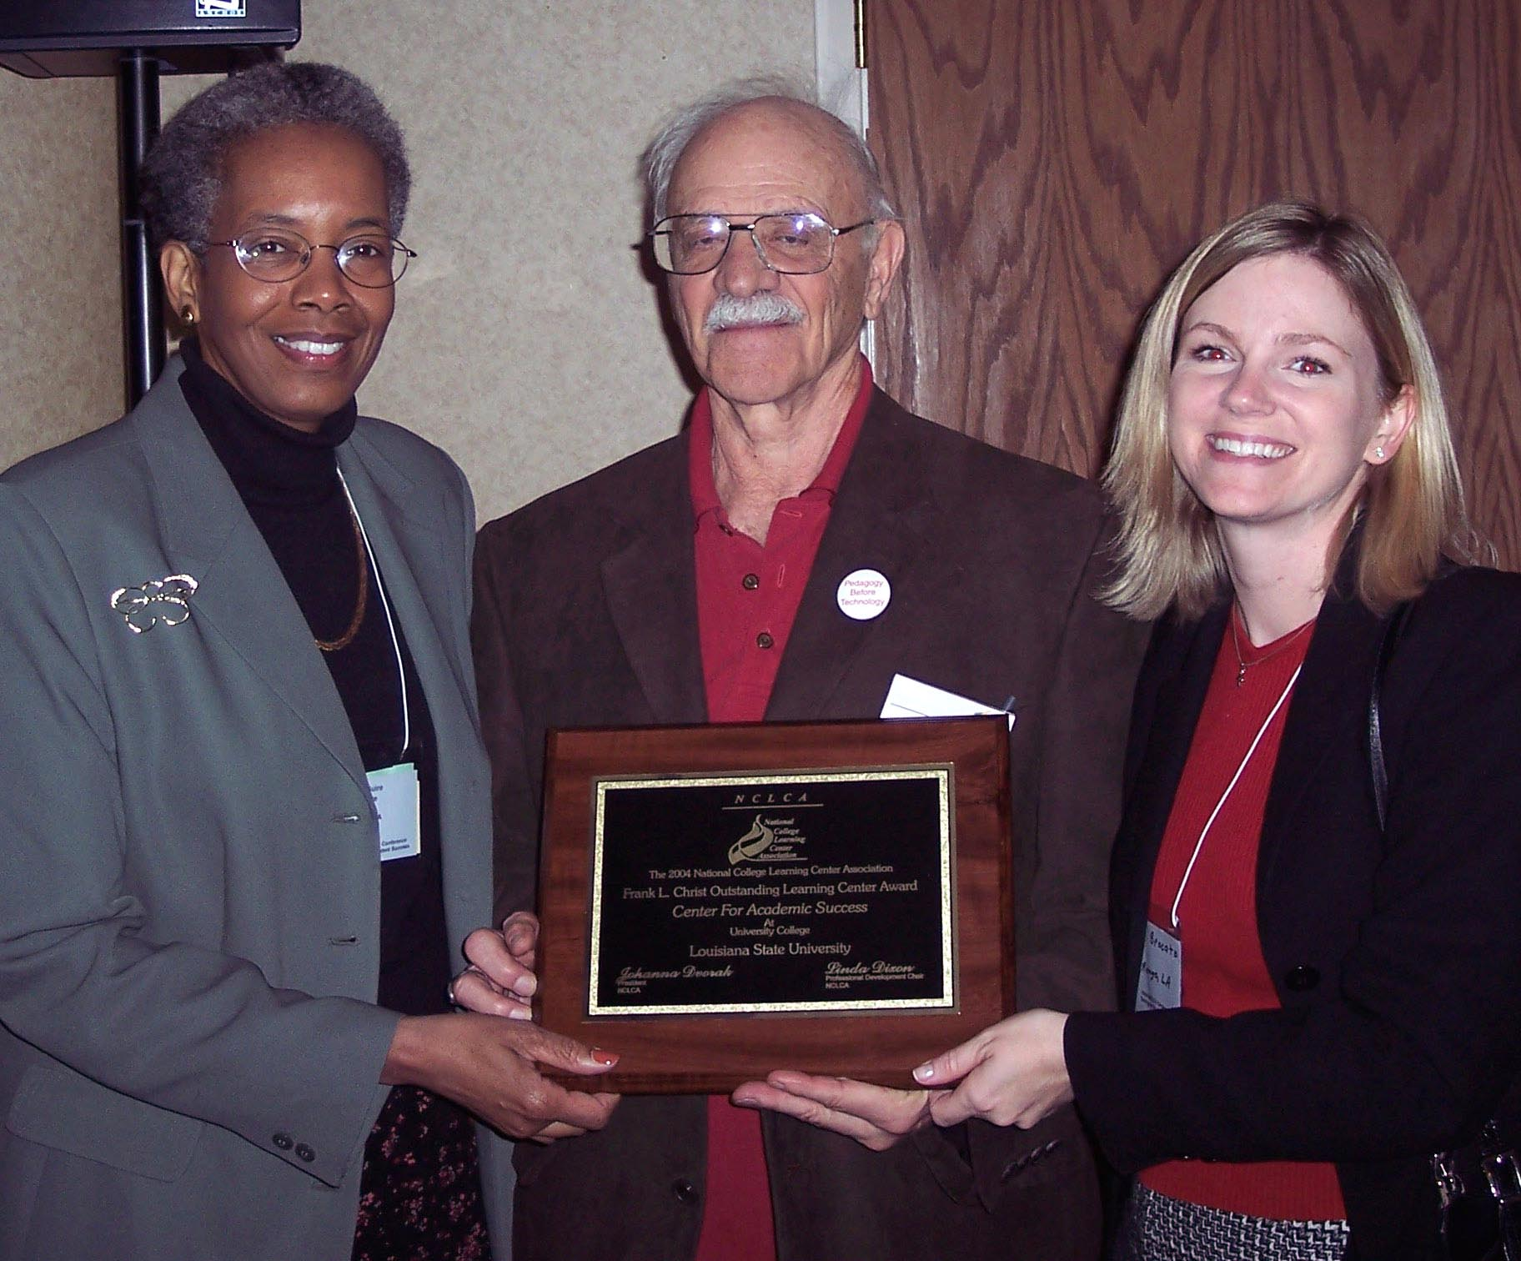

LSU Center for Academic Success
National College Learning Center Association
Frank L. Christ Outstanding Learning Center Award

Slide 4
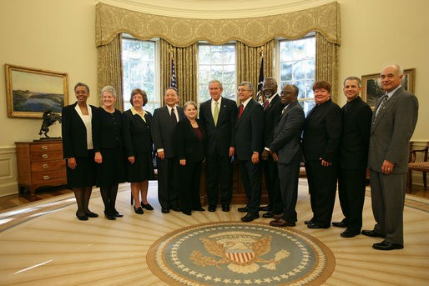
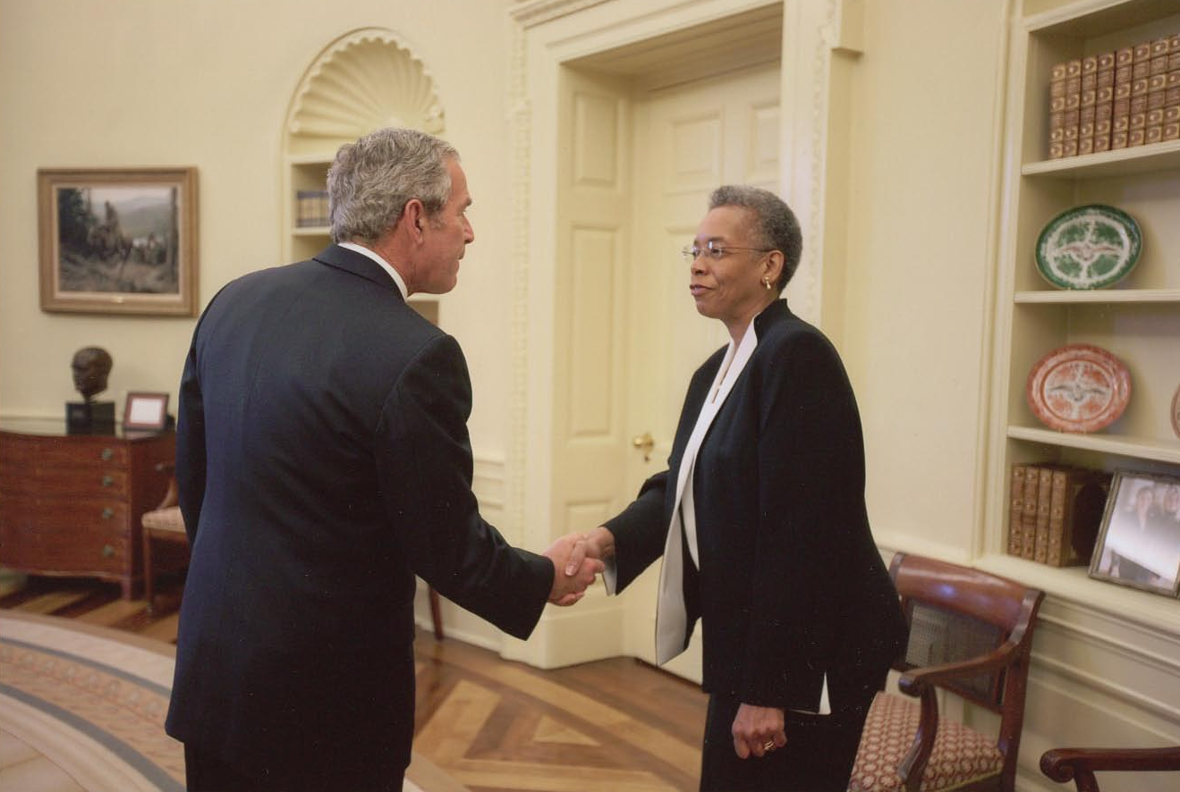
Presidential Award
White House Oval Office
November 16, 2007

Slide 5
The Story of Four LSU Chem 1201Students
Robert Final Grade:
42, 100, 100, 100 A
Kristy
60, 100, 99, 84 A
Blanche
63 79, 87, 100 A
Joshua
68, 50, (50), 87, 87, 97 A

Slide 6
Get the Most Out of Homework
Start the problems early--the day they are assigned
Do not flip back to see example problems; work them yourself!
Don’t give up too soon (<15 min.)
Don’t spend too much time (>30 min.)

Slide 7
Performance in Gen Chem I in 2011 Based on One Learning Strategies Session*
Attended Absent
Exam 1 Avg.: 71.65% 70.45%
Exam 2 Avg.: 77.18% 68.90%
Final course Avg*.: 81.60% 70.43%
Final Course Grade: B C
The one 50-min presentation on study and learning strategies resulted in an improvement of one full letter grade!
*Cook, E.; Kennedy, E.; McGuire, S. Y. J. Chem. Educ., 2013, 90 (8), 961–967

Slide 8
Performance in Gen Chem 1202 Sp 2013 Based on One Learning Strategies Session
Attended Absent
Exam 1 Avg.: 71.33% 69.27%
Homework Total 169.8 119.1
Final course Avg*.: 82.36% 67.71%
Final Course Grade: B D
The 50-min presentation on study and learning strategies resulted in an improvement of two letter grades!

Slide 9
Desired outcomes
You will analyze your current learning strategies
for Chemistry 1421
You will understand exactly what changes you need to implement to make an A in the course
You will have concrete strategies to use during the remainder of the semester, and you will
USE them in Chem 1421 and beyond!
You will become a more efficient learner by studying smarter, not necessarily harder

Slide 10
Reflection Questions
What’s the difference, if any, between
studying chemistry and learning chemistry?
For which task would you work harder:
A. Make an A on the test
B. Teach the material to the class?

Slide 11
Which mode have you been in?
Study mode
2. Learn mode
10
Countdown

Slide 12
For which task would you work harder?
Make an A on the test
2. Teach the material
10
Countdown

Slide 13
To Ace Chem 1421 (and everything else!)
Stay in learn mode, not study mode
Study as if you have to teach the material, not just make an A on the test

Slide 14
Why is this so important?
Because 1421 is Harder Than HS Chem
The course moves a lot faster
The material is conceptually more difficult and cumulative
The problems are more involved
The tests are less straightforward and require you to apply several concepts at one time

Slide 15
Example from Test 1:
Perform the indicated operations, expressing the answer to the proper number of sig figs and in scientific notation:
4.5600 x 10³ – 2.9 x 10¹
, where 8 is an exact number
8
A) 6 x 10²
B) 5.7 x 10²
C) 5.66 x 10²
D) 5.664 x 10²
E) 5.6638 x 10²

Slide 16
Example from Test 1 Correct Answer:
Perform the indicated operations, expressing the answer to the proper number of sig figs and in scientific notation:
4.5600 x 10³ – 2.9 x 10¹
, where 8 is an exact number
8
A) 6 x 10²
B) 5.7 x 10²
C) 5.66 x 10²
D) 5.664 x 10²
E) 5.6638 x 10²
39%
44%
4%
7%
6%
Correct answer

Slide 17
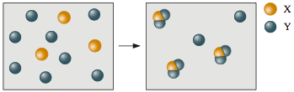
Second Example from Test 1:
Which of the reaction equations correctly describes this reaction?
A) 3 X + 8 Y → 3 XY₂ + 2 Y
B) 3 X + 6 Y → X₃Y₆
C) 3 X + 8 Y → X₃Y₈
D) X + 2 Y → XY₂
E) X + Y₂ → XY₂

Slide 18
Second Example from Test 1 Solution:
Which of the reaction equations correctly describes this reaction?
A) 3 X + 8 Y → 3 XY₂ + 2 Y
B) 3 X + 6 Y → X₃Y₆
C) 3 X + 8 Y → X₃Y₈
D) X + 2 Y → XY₂
E) X + Y₂ → XY₂
76%
1%
0%
23%
0%
Correct answer

Slide 19
Using Metacognition to Become an Expert Learner in Chemistry

Slide 20
Metacognition
The ability to:
think about thinking
be consciously aware of oneself as a problem solver
monitor and control one’s mental processing (e.g. “Am I understanding this material?”)
accurately judge one’s level of learning

Slide 21
This pyramid depicts the different levels of thinking we use when learning. Notice how each level builds on the foundation that precedes it. It is required that we learn the lower levels before we can effectively use the skills above.
Bloom’s Taxonomy
Evaluation
Making decisions and supporting views; requires understanding of values.
Graduate School
Combining information to form a unique product; requires creativity and originality.
Synthesis
Identifying components; determining arrangement, logic, and semantics.
Analysis
Undergraduate
Using information to solve problems; transferring abstract or theoretical ideas to practical situations. Identifying connections and relationships and how they apply.
Application
Restating in your own words; paraphrasing, summarizing, translating.
Comprehension
High School
Memorizing verbatim information. Being able to remember, but not necessarily fully understanding the material.
Knowledge
Louisiana State University  Center for Academic Success  B-31 Coates Hall  225-578-2872  www.cas.lsu.edu

Slide 22
At what level of Bloom’s did you have to operate to make A’s or B’s in high school?
Knowledge
Comprehension
Application
Analysis
Synthesis
Evaluation
10
Countdown

Slide 23
At what level of Bloom’s do you think you’ll need to be to make an A in Chem 1421?
Knowledge
Comprehension
Application
Analysis
Synthesis
Evaluation
10
Countdown

Slide 24
How do you move yourself higher on Bloom’s Taxonomy?
Use the Study Cycle!

Slide 25

The Study Cycle
4
Reflect
3
Review
Preview
Preview before class – Skim the chapter, note headings and boldface words, review summaries and chapter objectives, and come up with questions you’d like the lecture to answer for you.
4
Reflect
Attend
Attend class – GO TO CLASS! Answer and ask questions and take meaningful notes.
Review after class – As soon after class as possible, read notes, fill in gaps and note any questions.
Review
Study – Repetition is the key. Ask questions such as ‘why’, ‘how’, and ‘what if’.
Intense Study Sessions* - 3-5 short study sessions per day
Weekend Review – Read notes and material from the week to make connections
Study
Assess your Learning – Periodically perform reality checks
Am I using study methods that are effective?
Do I understand the material enough to teach it to others?
Assess
*Intense Study Sessions
1 | Set a Goal | (1-2 min) | Decide what you want to accomplish in your study session
2 | Study with Focus | (30-50 min) | Interact with material- organize, concept map, summarize, process, re-read, fill-in notes, reflect, etc.
3 | Reward Yourself | (10-15 min) | Take a break– call a friend, play a short game, get a snack
4 | Review | (5 min) | Go over what you just studied
Center for Academic Success
B-31 Coates Hall ▪ 225.578.2872 ▪www.cas.lsu.edu

Slide 26
Effective Metacognitive Strategies
Always solve problems without looking at an example or the solution
Memorize everything you’re told to memorize (e.g. polyatomic ions)
Always ask why, how, and what if questions
Test understanding by giving “mini-lectures” on concepts
Spend time on chemistry every day
Use the Study Cycle with Intense Study Sessions
Attend SI sessions on a regular basis
Aim for 100% mastery, not 90%!

Slide 27
Concept maps facilitate development of higher order thinking skills

Slide 28
Chapter Map
Title of Chapter
Primary Headings
Subheadings
Secondary Subheadings

Slide 29
Compare and Contrast
Concept #1
Concept #2
How are they similar?
How are they different?

Slide 30
Which One of the Next Two Slides More Accurately Describes YOUR Actions Before Test 1?

Slide 31
Top 5 Reasons Folks Did Not Do Well on Test 1 in Gen Chemistry in Fall 2009:
1. Didn’t spend enough time on the material
2. Started the homework too late
3. Didn’t memorize the information I needed to
4. Did not use the book
5. Assumed I understood information that I had read and re-read, but had not applied

Slide 32
Top 5 Reasons Folks Made an A on Test 1:
1. Did preview-review for every class
2. Did a little of the homework at a time
3. Used the book and did the suggested problems
4. Made flashcards of the information to be memorized
5. Practiced explaining the information to others

Slide 33
Which group did you most resemble?
Group that did not do well
2. Group that made an A
10
Countdown

Slide 34
Email from Joshua, Chem 1201 student
“…Personally, I am not so good at chemistry and unfortunately, at this point my grade for that class is reflecting exactly that. I am emailing you inquiring about a possibility of you tutoring me.”
April 6, 2011
----------------------------------------------------------
“I made a 68, 50, (50), 87, 87, and a 97 on my final. I ended up earning a 90 (A) in the course, but I started with a 60 (D). I think what I did different was make sidenotes in each chapter and as I progressed onto the next chapter I was able to refer to these notes. I would say that in chemistry everything builds from the previous topic.
May 13, 2011 Semester GPA: 3.8

Slide 35
Get the Most Out of Homework
Reprise
Start the problems early--the day they are assigned
Do not flip back to see example problems; work them yourself!
Don’t give up too soon (<15 min.)
Don’t spend too much time (>30 min.)

Slide 36
Get the Most from SI Sessions, Tutorial Centers, Office Hours, and Study Groups
Try to understand the concept or work the problem by yourself first
Come prepared to ask questions
Explain the material to the tutor or instructor

Slide 37
CAS Resources

Slide 38

Study Group Starter Kit
CAS Study Group Starter Kit
www.cas.lsu.edu/
study-groups

Slide 39

CAS Services
Learning Strategies Academic Support
CONSULTATIONS
Students
Faculty
TUTORING
Walk-in
On-line
WORKSHOPS and Outreach
SUPPLEMENTAL INSTRUCTION
All CAS Services have been documented to improve academic performance and student retention

Slide 40
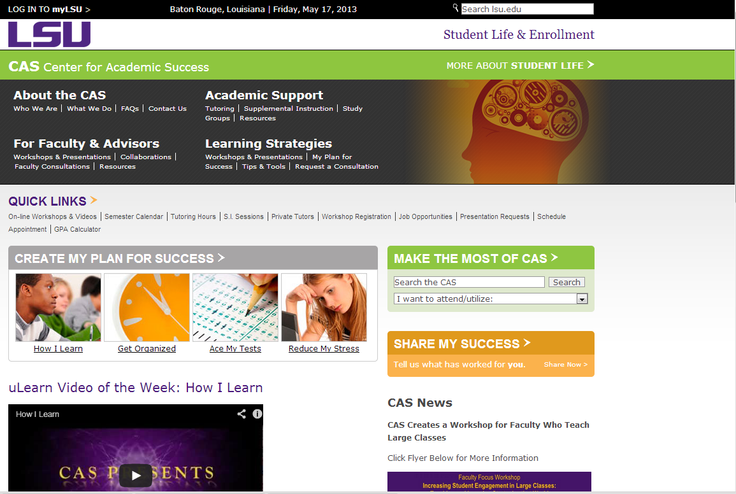


Slide 41
Challenge to Dr. Cook’s students
Metacognition Discussion – Sep 23, 2013
Average on Exam 2: 120 (80%)
How do I know you CAN do this?
Because students at the
LSU Dental School did it!

Slide 42
The 2004 LSU Dental School First Year Class:
An Amazing Success Story!
Metacognition Discussion – August 13, 2004
Histology Exam – August 23, 2004
Previous class averages: 74 – 78
Challenge to class on August 13: 84 average
Reported average on August 24: 85!

Slide 43
Writing Exercise
What strategy will you use
for the next three weeks?

Slide 44
Which one strategy are you most likely to implement for the next test?
Do preview review
2. Do homework differently
3. Use the textbook more
4. Do more problems
5. Practice teaching the material
6. None of the above
10
Countdown

Slide 45
If you don’t try it within the next 48 hours...
… you probably never will.

Slide 46
Final Note
Please visit our website at www.cas.lsu.edu.
We have on-line workshops and information that will teach you even more effective study strategies. We wish you a fantastically successful future!
The Center for Academic Success
B-31 Coates Hall
www.cas.lsu.edu

